Slide 1





Simple Calculator
Abdulbasit A-23
Shahid A-24
Deep A-19

Slide 2


Objective
We have develop a simple calculator that performs basic arithmetic operations.
To create a user-friendly interactive calculator on a webpage using various
web development tools
To deliver a seamless, responsive user experience

Slide 3
Technology used
Below is an overview of the technologies used in this project and their roles
HTML: provides basic structure of web page
CSS: Styles the HTML elements
JAVASCRIPT: Adds interactive functionality to the webpage
JQUERY: Simplifies DOM manipulation and event handling

Slide 4
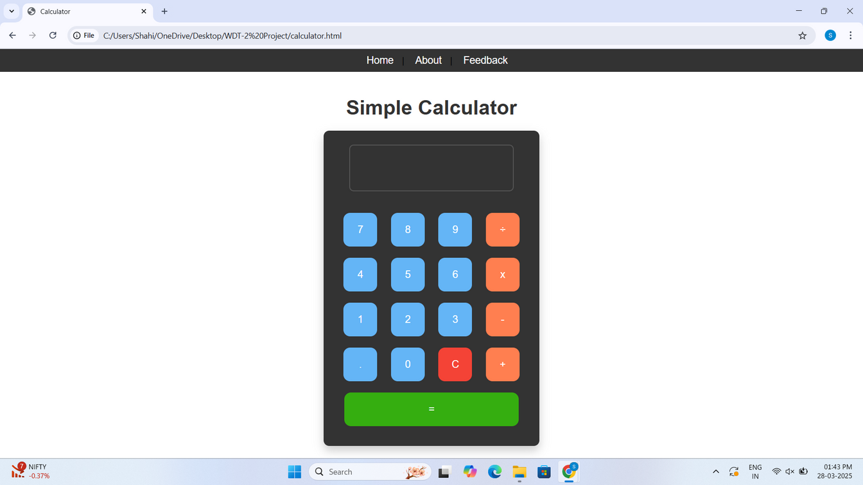
Page Description
This site features an easy interactive calculator to carry out easy arithmetic computations. It is a prime example of how present-day web development techniques are evolving and applications are accessible directly through browsers rather than requiring a separate application

Slide 5
Form design and Validation
A Clean & Easy to Read Layout: The layout has clearly defined labels for each input field along with organized fields to help provide an easy to navigate experience.
Instant User Input Validation: JavaScript/jQuery can validate users' entries in real-time when users are entering their data which helps users obtain instant feedback after their submission.
Error Messaging: It shows error message to help users fix anything wrong before submission.
Responsive Design: Layout adjusts, and behaves differently in various screen sizes with regard to size and fields.

Slide 6
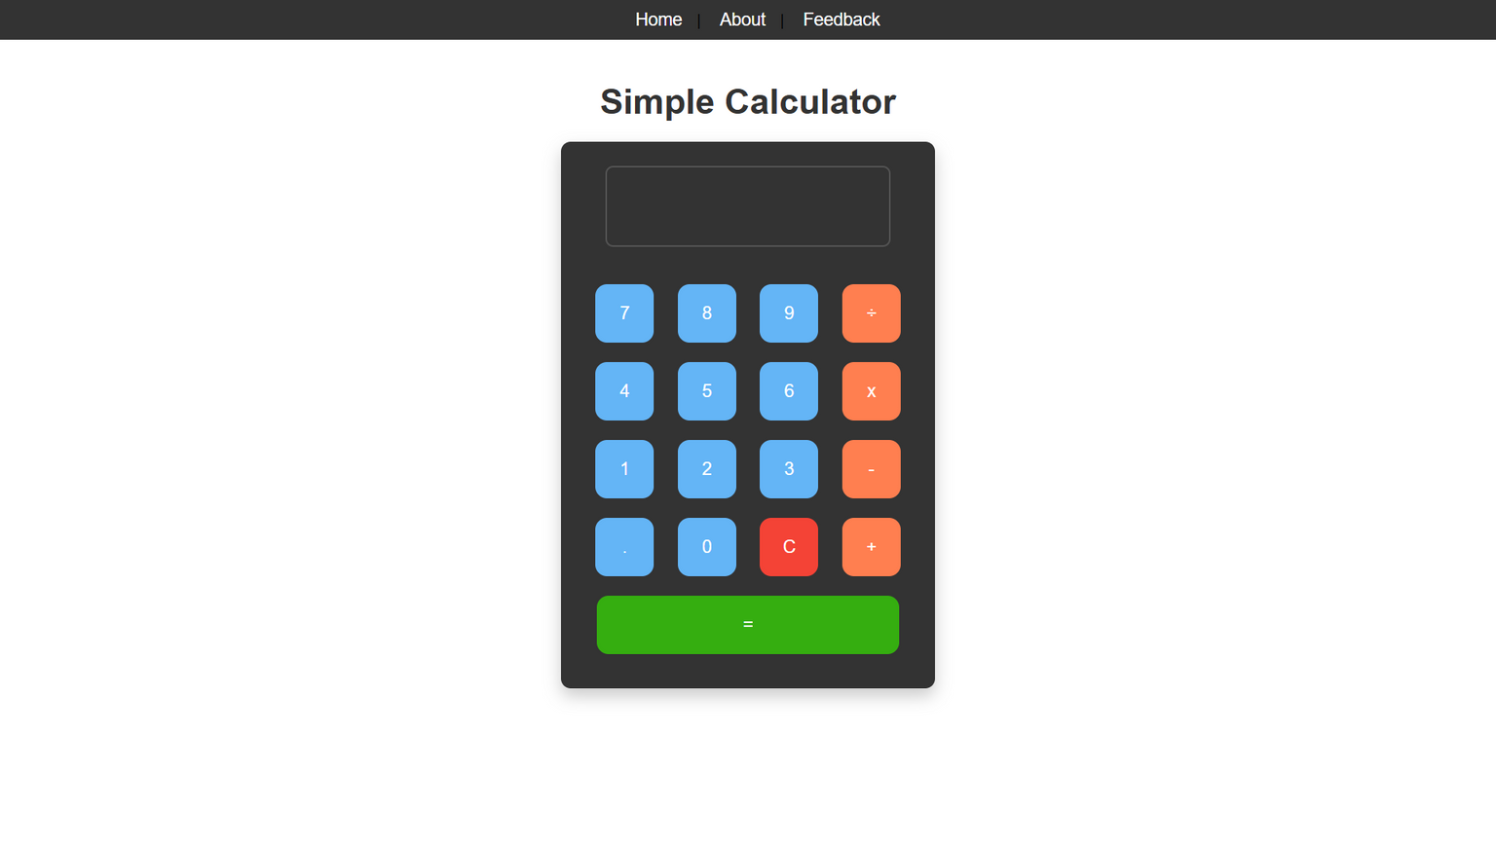
Form design and Validation
A Clean & Easy to Read Layout:

Slide 7
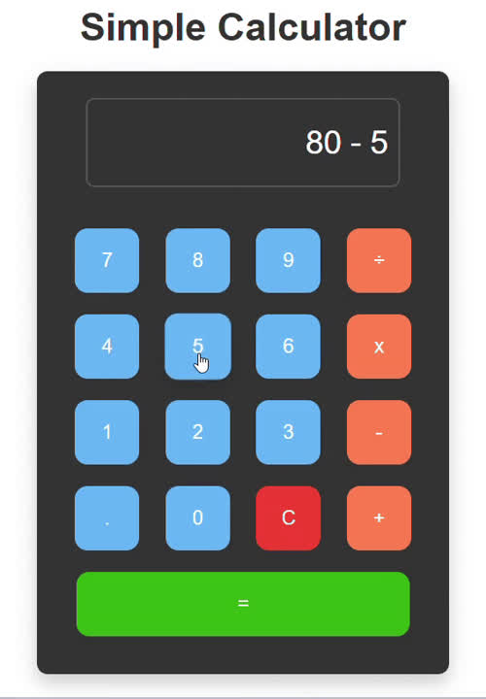
Form design and Validation
Instant User Input Validation:

Slide 8
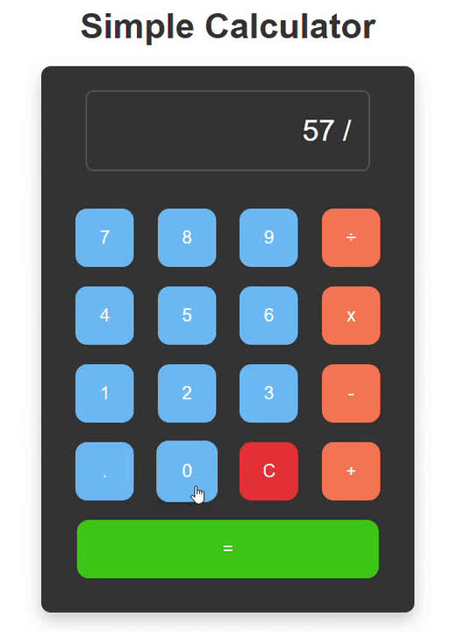
Form design and Validation
Error Messaging:

Slide 9
JQuery usage
Simplifies DOM manipulation and event handling
Reduces code complexity for interactive elements
Input Capture: Collects clicks of buttons presented and gathers the value currently shown on the input box.
Arithmetic Processing: Keeps values from prior operations (addition, subtraction, multiplication, and division) and performs calculations on them.
Display Update: Users dynamically enter their required inputs, operators and results are shown.
Error Handling: Calculation errors (such as division by zero) are identified and values are cleared when appropriate.
Audio Feedback: Beeps for audio prompt on button clicks and errors.
Reset Functionality: On pressing the clear button all inputs are removed and the calculator will become reset.

Slide 10
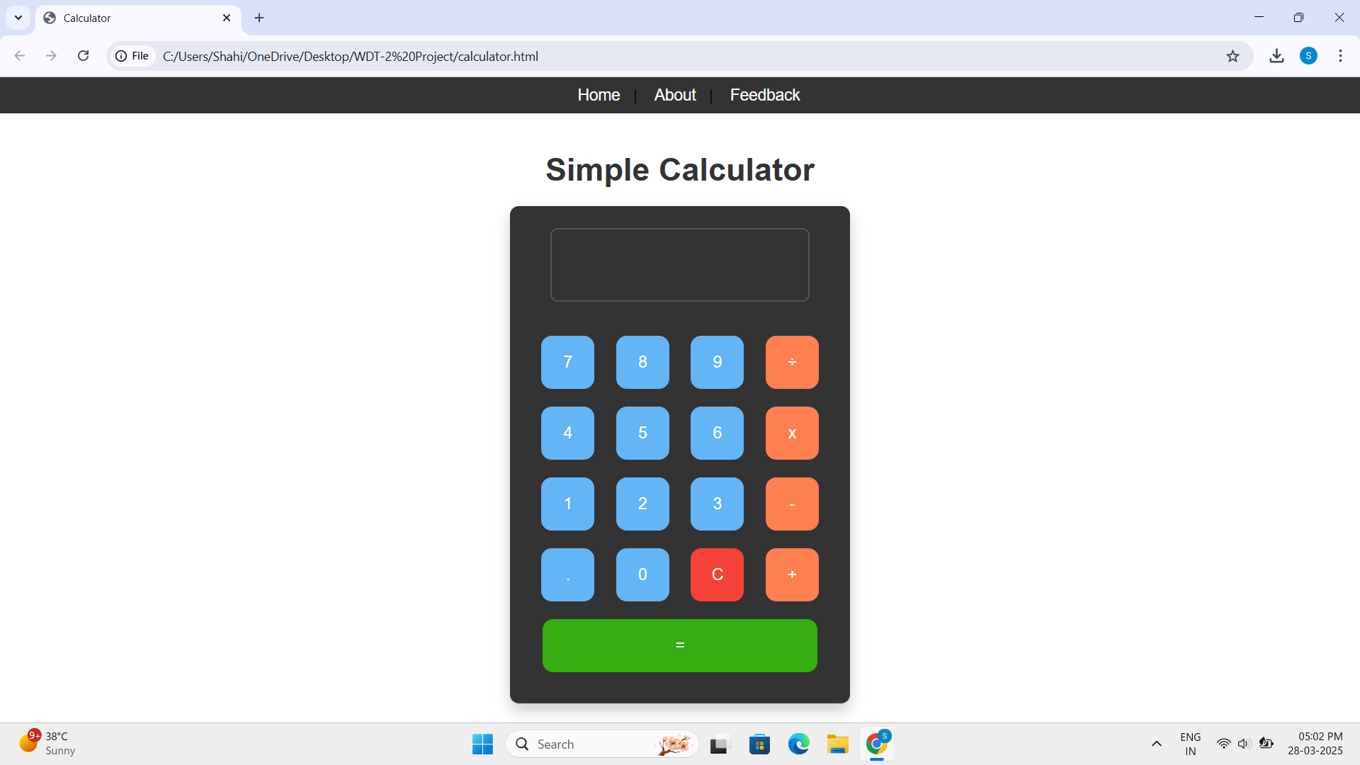
Screenshots

Slide 11
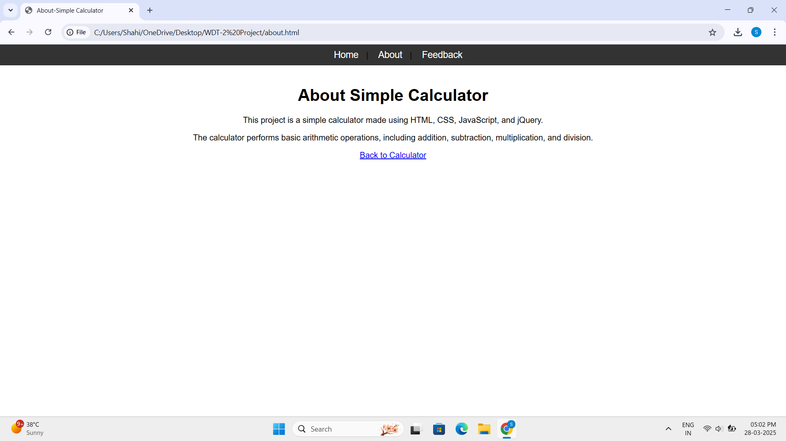
Screenshots

Slide 12
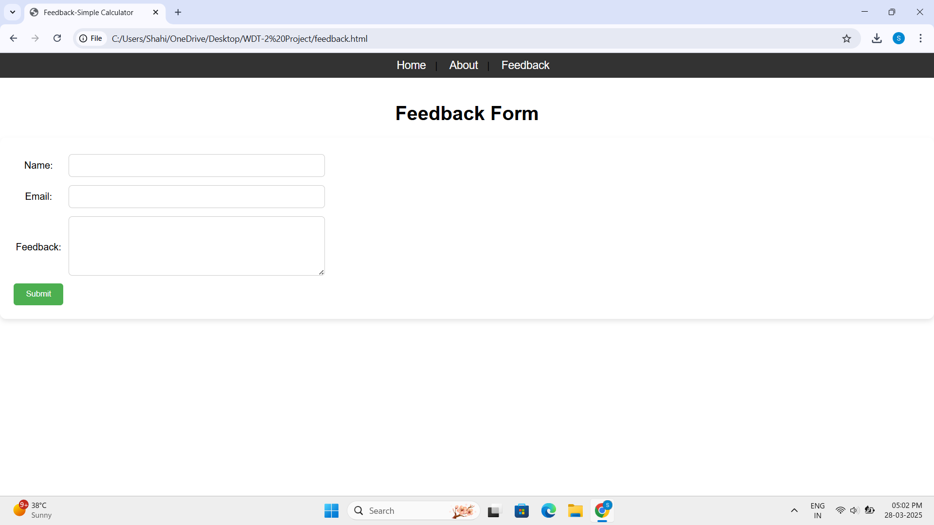
Screenshots

Slide 13

Conclusion
A simple, interactive calculator built with modern web development techniques.
Offers a user-friendly interface with real-time validation and dynamic updates.
Demonstrates the effective integration of key web tools for building responsive applications.

